Slide 1

Welcome to our thesis presentation
Date: 8th December
Session: Fall 2018

Slide 2
Members information:
Group Members:
Sushmita Roy Tithi - 14201051
Afifa Aktar - 15101015
Fahimul Aleem - 15101126
Supervised by:
Dr. Amitabha Chakrabarty
Associate Professor

Slide 3
Machine Learning Approach for ECG Analysis and predicting different heart diseases

Slide 4
Introduction
Motivation
Objective

Slide 5
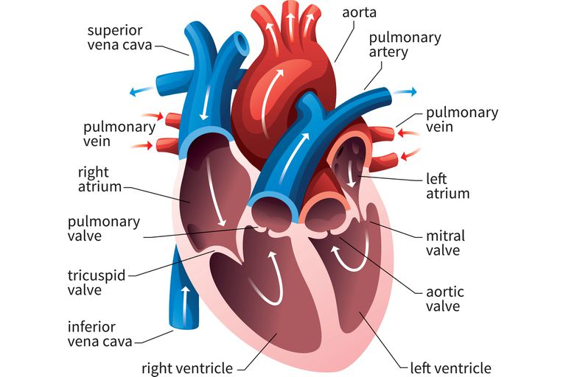
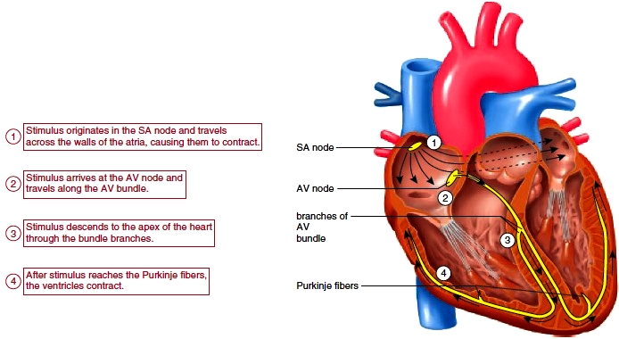
The Human Heart

Slide 6
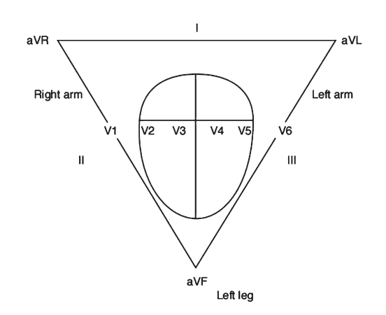
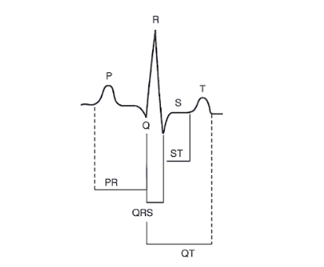
ECG process and graph

Slide 7
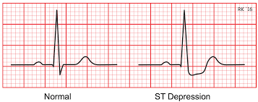
Diseases Analyzed
Coronary Artery Disease

Slide 8
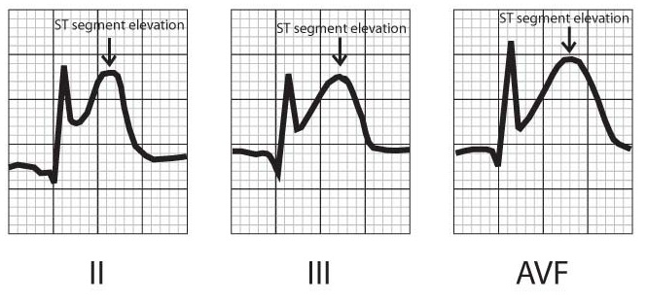
Myocardial Infarction

Slide 9
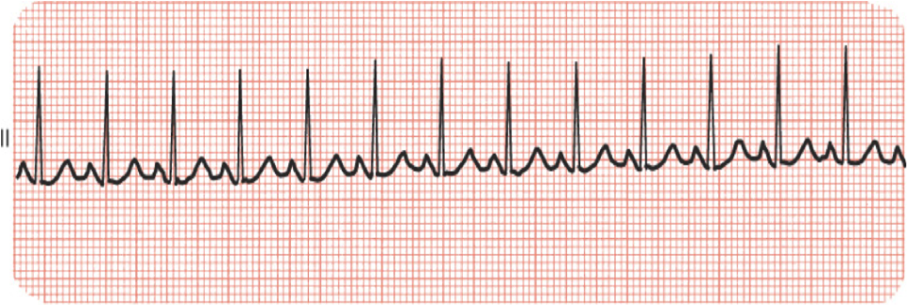
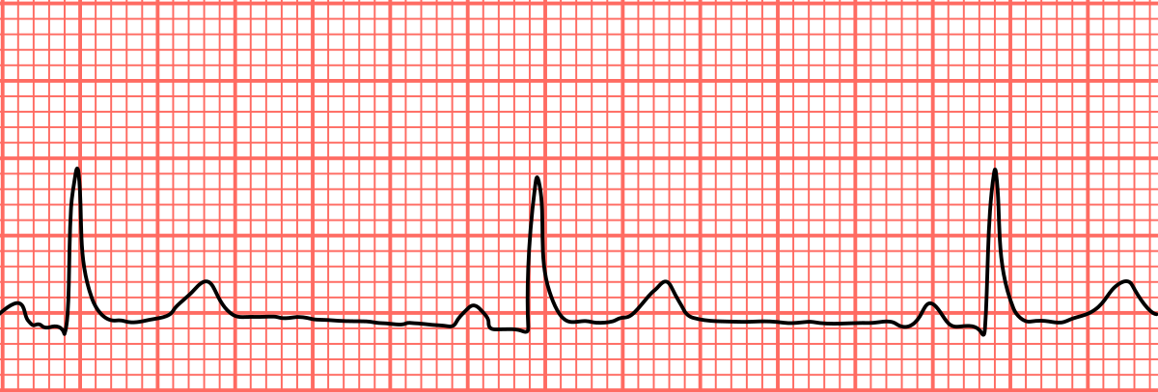
Sinus Tachycardia
Sinus Bradycardia

Slide 11
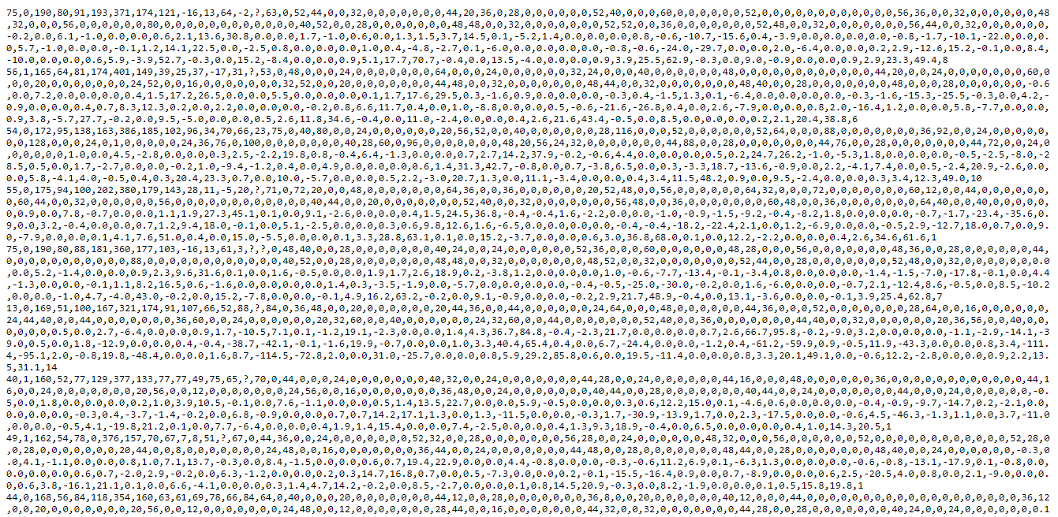
Dataset
Data found from UCI Machine Learning Repository database
Rows are instances (452 instances) and columns are attributes (279 attributes)
206 of these values are linear and rest are nominal
Missing data were adjusted as per our requirement

Slide 12
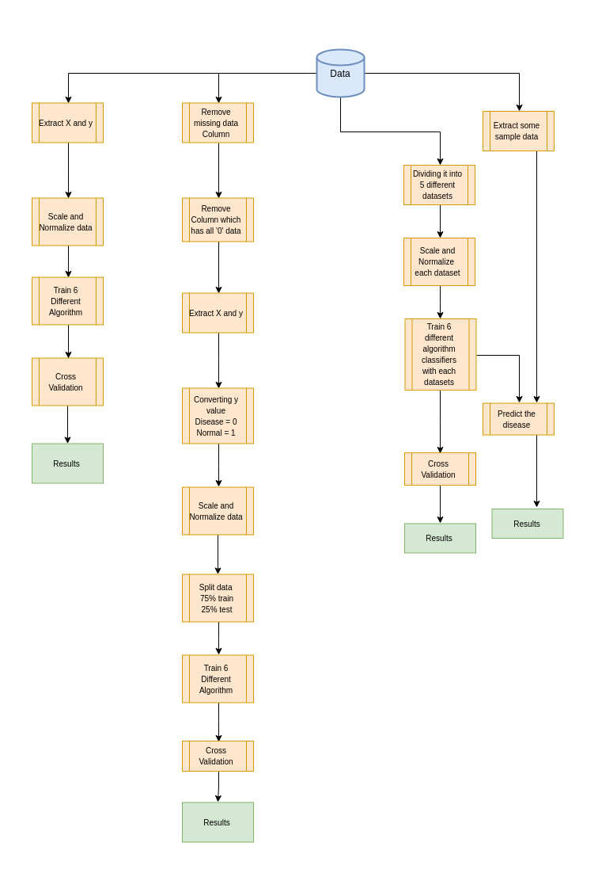
Workflow

Slide 13
Algorithms Implemented
Logistic regression
Decision tree
Nearest neighbour
Naïve Bayes
Support Vector Machine (SVM)
Artificial Neural Network

Slide 14
Results

Slide 15
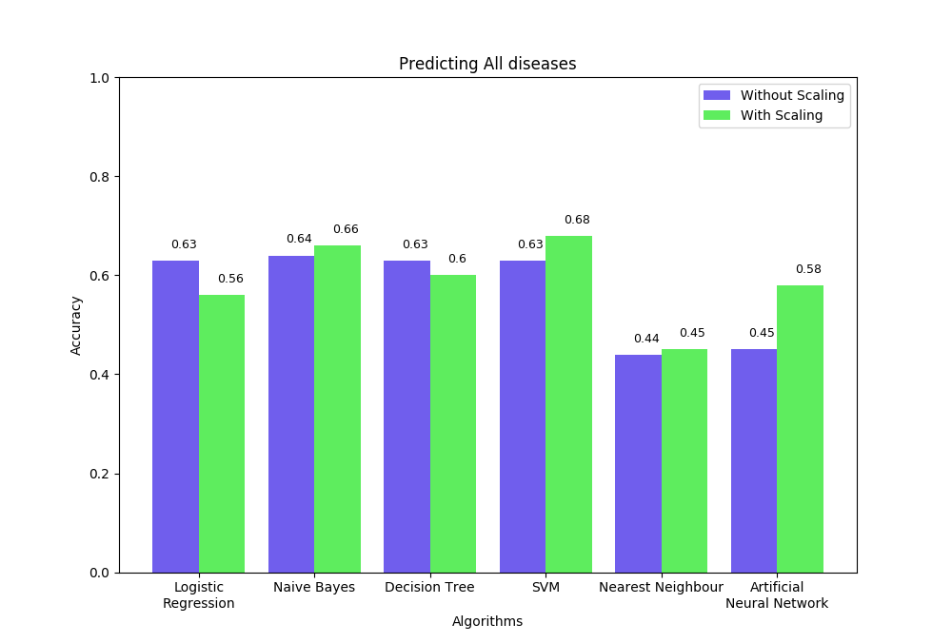
Results

Slide 16
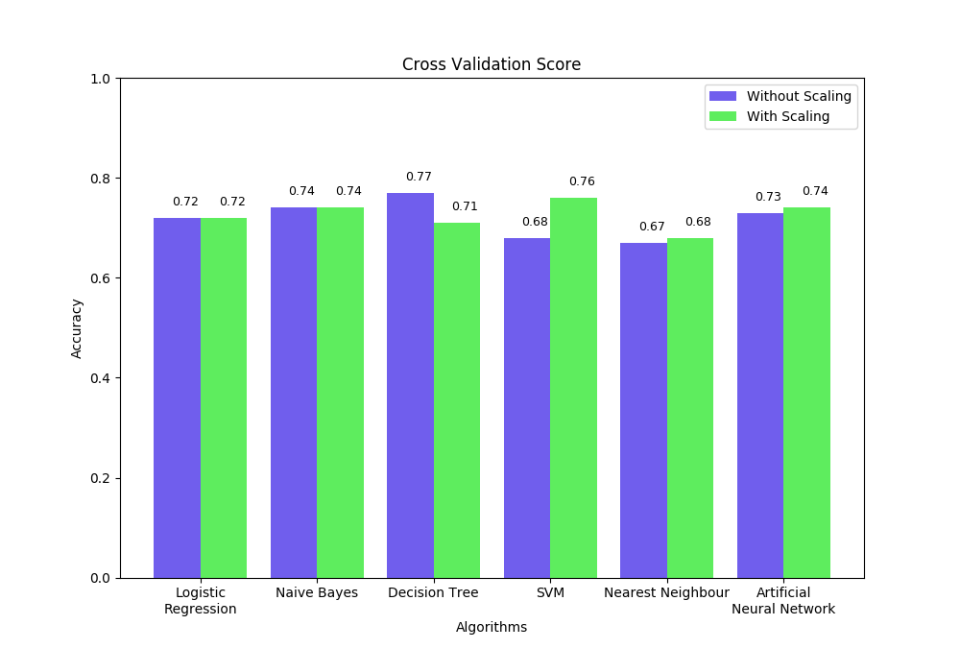
Results

Slide 17
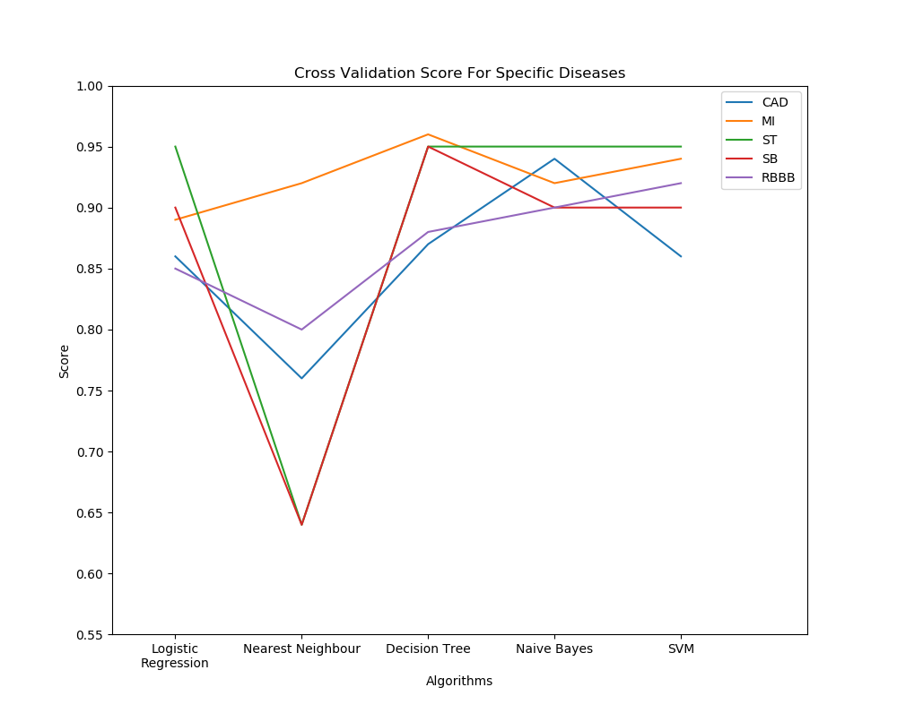
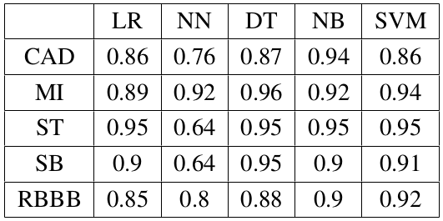
Cross Validation score for
individual disease and algorithm

Slide 18
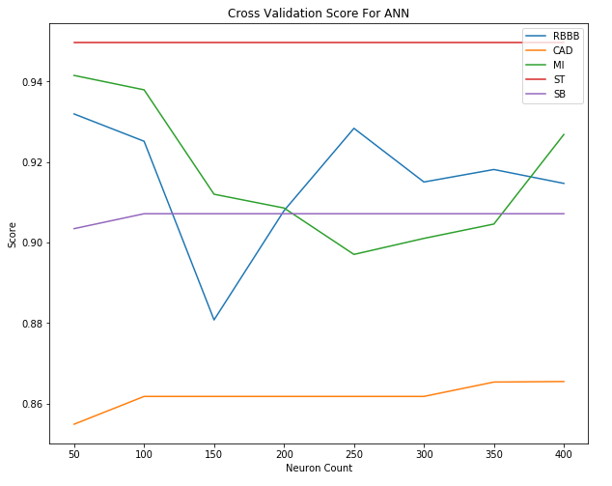
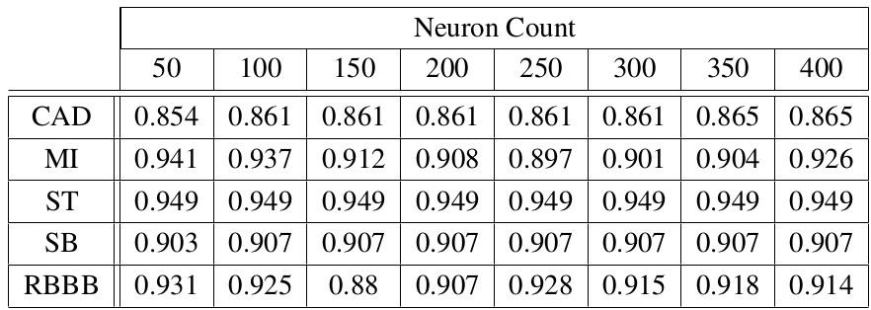
CV score of ANN of
individual disease vs Neuron count

Slide 19
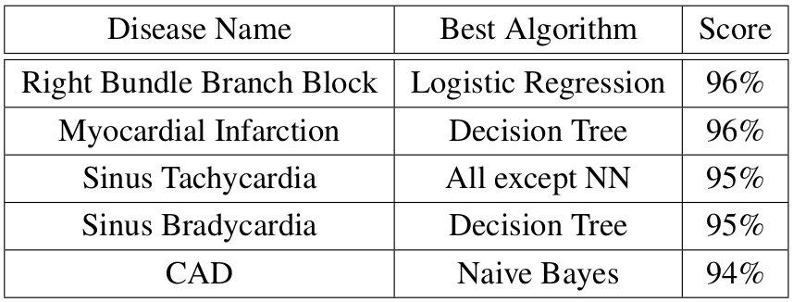
Result Analysis

Slide 20
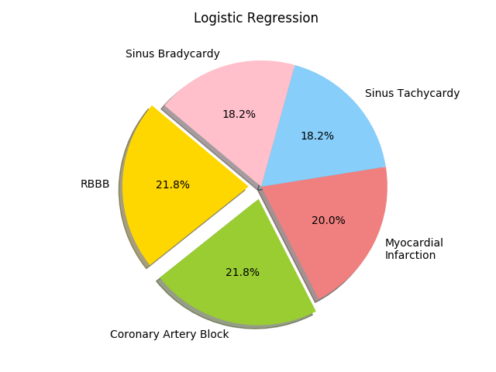
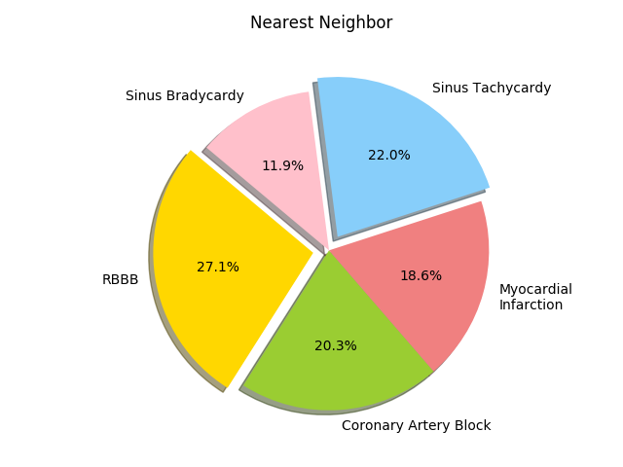
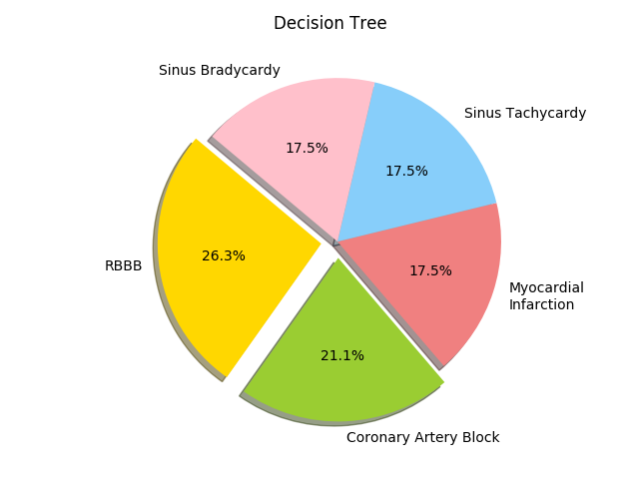
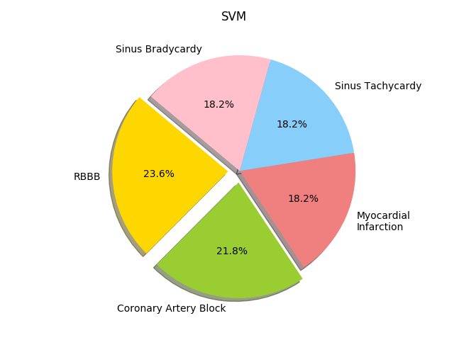
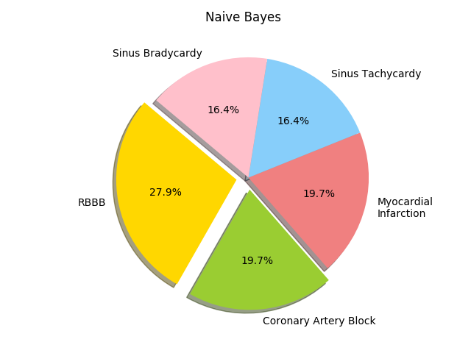
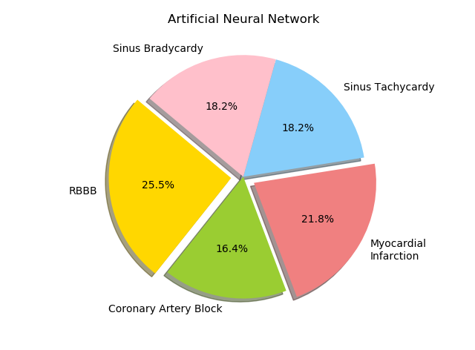
Prediction of disease with an input data set

Slide 21
Comparison
Used the same CV settings which was used by the Bilkent University
VFI5 vs 6 different algorithms
Classifying Normal vs abnormal arrhythmia
Isolate a single disease increases accuracy

Slide 22
Conclusion
Future plan and works

Slide 23
References
Scoville, H. (2018). Evolution of the human heart
Asfaqul Islam, A. (2015). A real-time ecg warning system on myocardial infarction, hyperkalemia and atrioventricular block
Dheeru, D. and Karra Taniskidou, E. (2017). UCI machine learning repository
Grzymala-Busse, J. W. (1993). Selected algorithms of machine learning from examples. Fundam. Inform. , 18:193–207
Ray, S. (2017). Essentials of machine learning algorithms (with python and r codes).
Analytics Vidhya. Re.
Ripley, B. D. (2007). Pattern recognition and neural networks. Cambridge university press

Slide 24
THANK YOU!

Slide 25
Attributes of the subsets
Coronary Artery Disease
-Weight, heart rate, QRS duration, P-R interval, Q-T interval, T interval, Q wave, S wave,Existence of ragged T wave, Existence of diphasic derivation of T wave
Myocardial Infarction
-Weight, heart rate, QRS duration, P-R interval, Q-T interval, T interval, Q wave, S wave, Existence of ragged T wave, Existence of diphasic derivation of T wave
Sinus Tachycardia
-age, heart rate, Q wave, R wave, S wave, Amplitude of Q wave, R wave, S wave , * 0.1 milivolt
Sinus Bradycardia
-age, heart rate, Q wave, R wave, S wave, Amplitude of Q wave, R wave, S wave , * 0.1 milivolt
Right Bundle Branch Block
- Q wave, R wave, S wave, Amplitude of Q wave , R wave, S wave , * 0.1 milivolt,

Slide 26
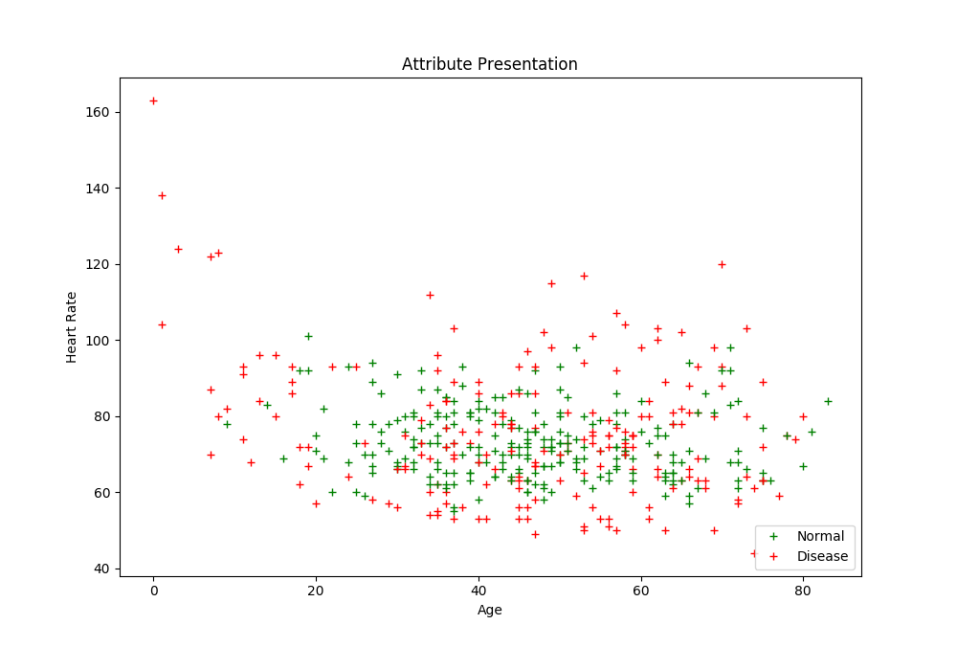
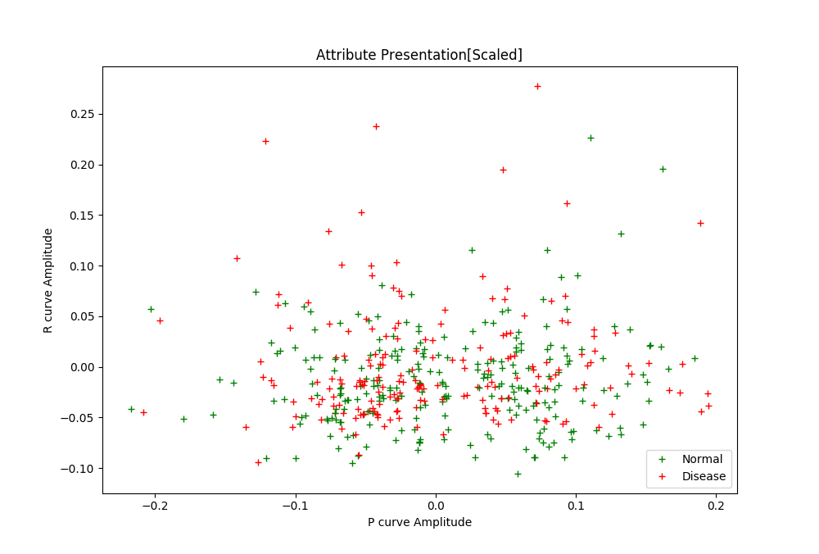
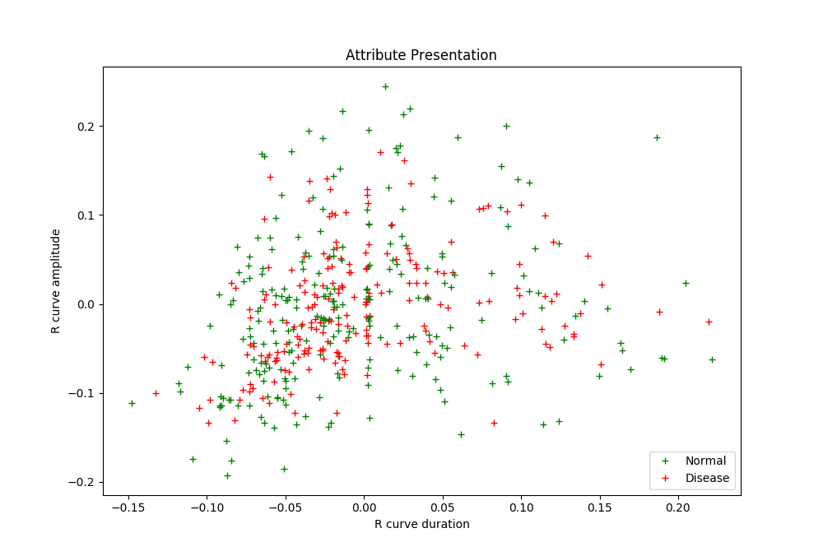
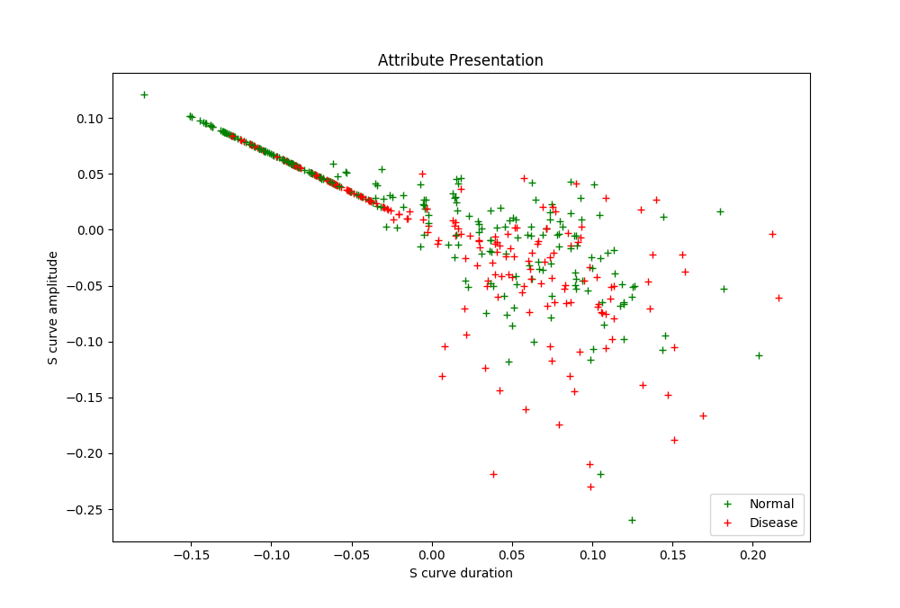

Slide 27
